Slide 1

Collective modes in Condensed Matter Physics
Sparsh Mishra

Slide 2
Full disclosure
A lot of intro topics.
Slides are just a rough skeleton. Will most probably have to expand on it.
I’ll Try to keep it jargon free. But if I do use some, just ask!
Some calculations “left for the reader”. Not a lot …. hopefully

Slide 3
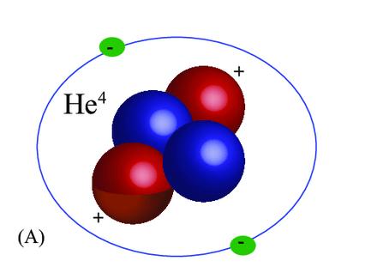
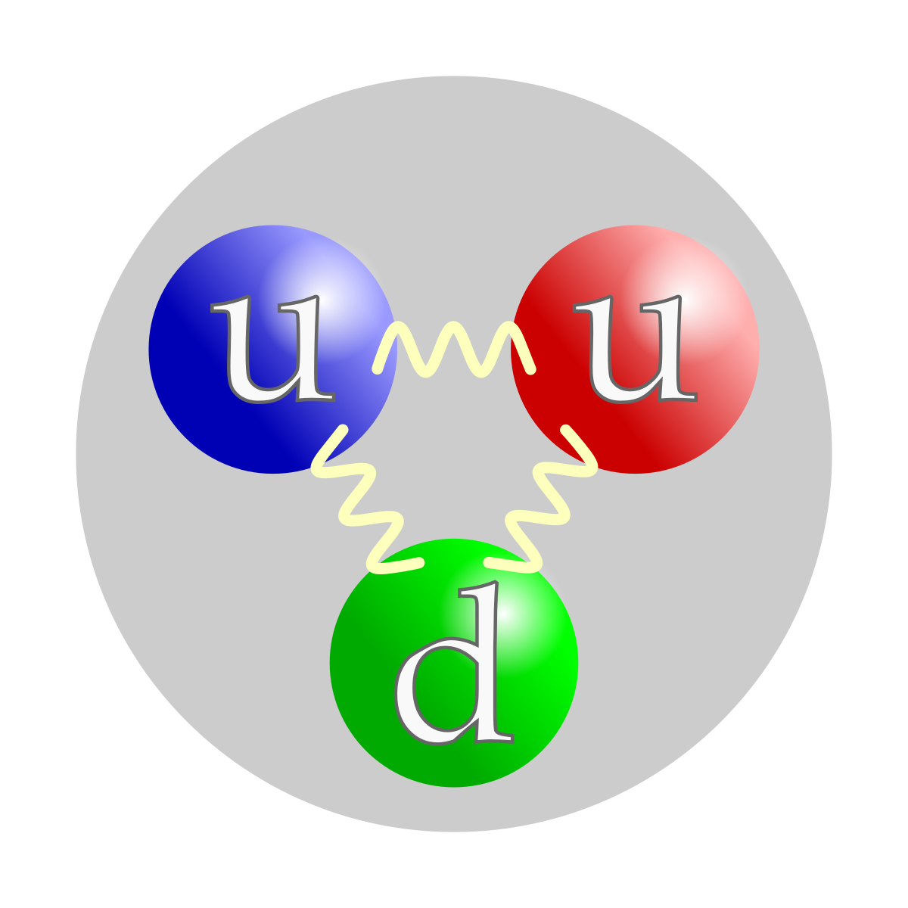
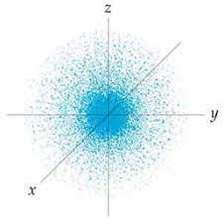
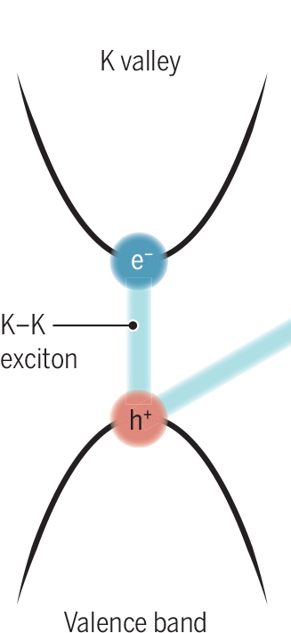

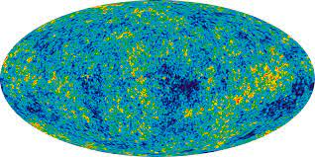
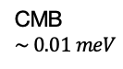
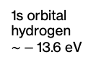
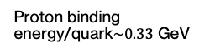
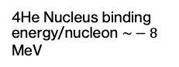

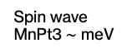

Energy scales of the universe
Condensed matter physics
Exciton binding energy in Si $\sim \text{meV}$
Energy required to tear a piece of paper/ mole ~ -1 eV
Spin wave MnPt3 $\sim \text{meV}$
1s orbital hydrogen $\sim −\text{13.6 }\text{eV}$
4He Nucleus binding energy/nucleon $\sim −\text{8} \text{MeV}$
Proton binding energy/quark$\sim 0.33 \text{GeV}$
CMB
$$\sim 0.01 meV$$
Lattice vibrations Pb $\sim \text{meV}$
Vacuum (0 level)

Slide 4
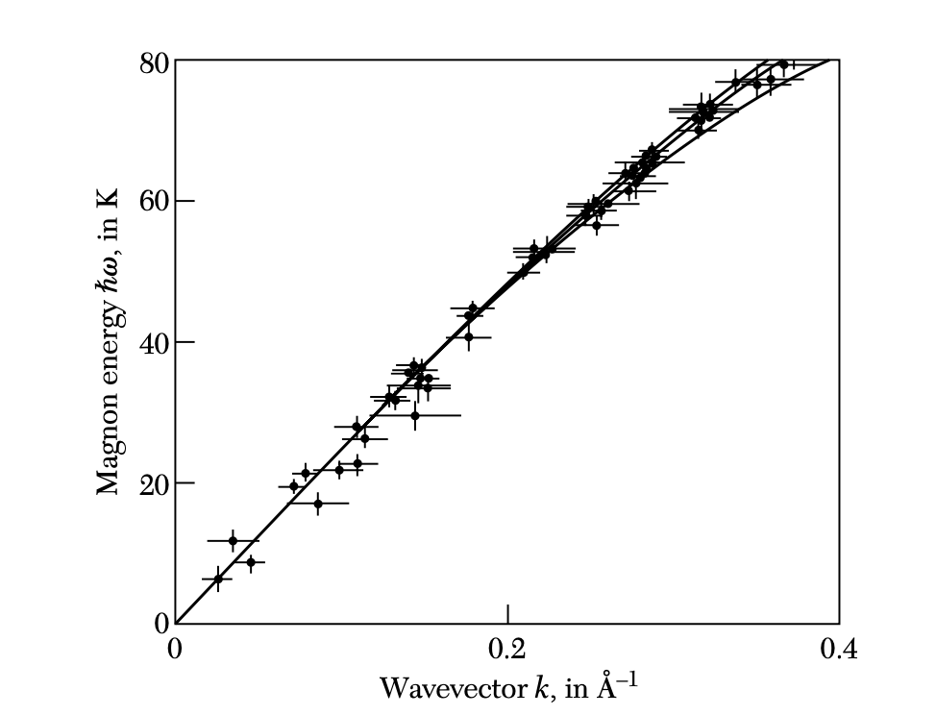
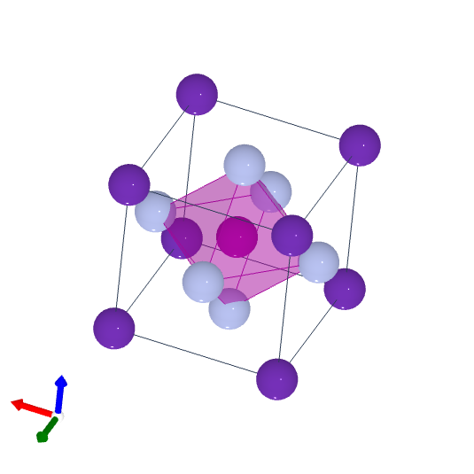
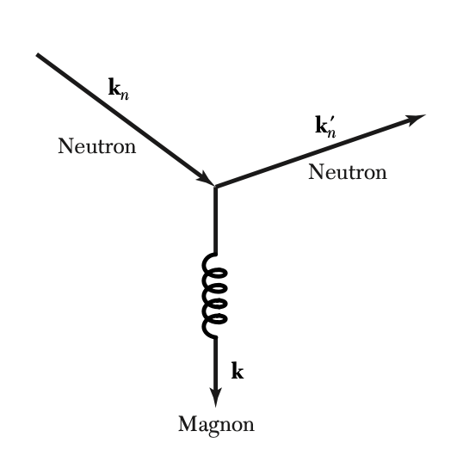


Some lab results- Inelastic neutron scattering
Reference momenta:
Colour red $k =0.001 {A^{o}}^{−1}$
Microwave $k =0.0006 {A^{o}}^{−1}$
???
Purple: Rb+
Magenta:Mn
RbMnF3 inelastic neutron scattering
Blueish: F

Slide 5



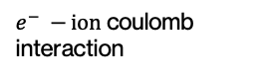
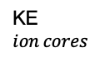
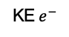
Theory of everything condensed matter physics
At this energy scale non-relativistic quantum mechanics is used to describe the physics
Many body Schrodinger equation $N_{e}$ electrons and $N_{n}$ nuclei:
KE $e^{−}$
KE $ion cores$
Coulomb repulsion electrons
Coulomb interaction ions
$e^{−} −ion$ coulomb interaction
Very complicated.
Cannot be solved directly, moreover initial conditions impossible to get
Need some simplifications
1) Ions much heavier than electrons $⇒$ Treat classically (as parameters $\{R_{I}\}$) and still.

Slide 6
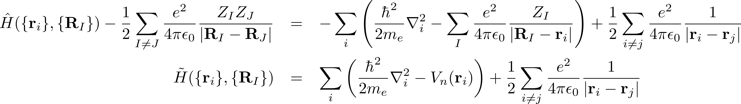
Constant
Effect of nuclear potential on i’th electron
Single particle
Two particle interaction
Gone from complicated mess to (still but) less complicated mess
Next simplification (subtle): Remove effect of coulomb repulsion and solve the problem
(my opinion) Most of condensed matter physics is finding the essence of the coulomb interaction + permutation symmetry of the electron. Conductors-Insulators-Magnets-Superconductors-ferroelectrics-Chern insulators- …….

Slide 7
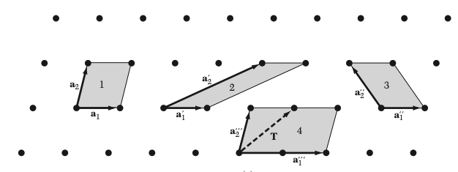

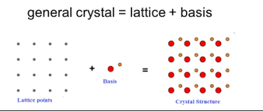



Solid state theory- Lattices
Lattice: a periodic array of points
2D
At each point you can attach an atom (or atoms)
Called a basis
Mass of electron $≪$ Mass of ions
$⇒$We can just consider the ions as still and just think of the electrons (decoupled)
$↔$ Electron in a static periodic potential

Slide 8
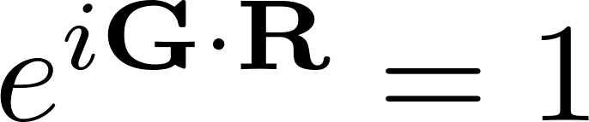

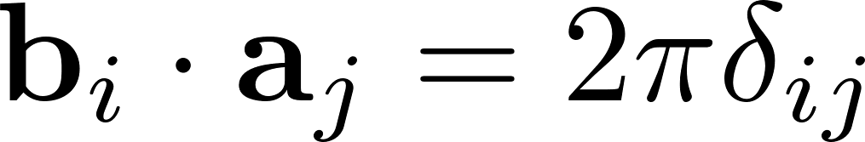
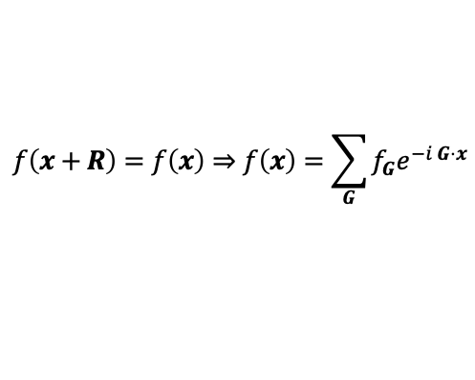
Reciprocal lattice
Define a new set of vectors:
(hence the name – Reciprocal/dual)
G is also periodic
Usefulness:
A function periodic in R can be expanded in G (Fourier exponential series):
$$f\left(x+R\right)=f\left(x\right)⇒f\left(x\right)=\sum_{G}{{f_{G}e}^{−i G⋅x}}$$

Slide 9
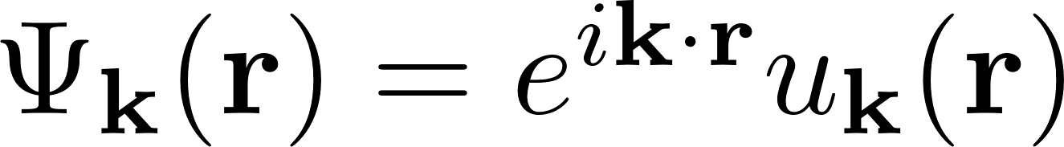

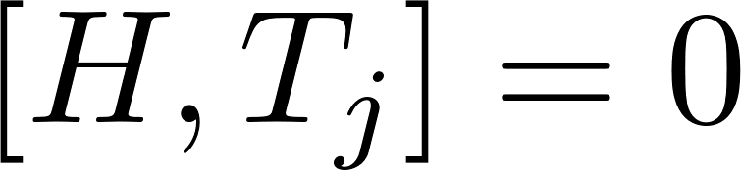
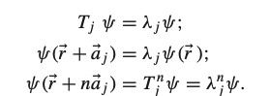
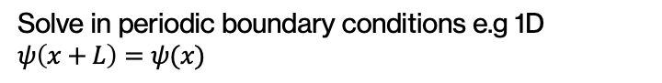
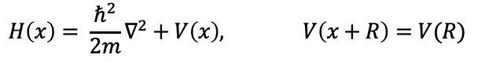

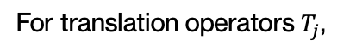
Electron in a periodic potential-Bloch’s theorem
$$H\left(x\right)= \frac{ℏ^{2}}{2m}∇^{2}+V\left(x\right), V\left(x+R\right)=V(R)$$
Solve in periodic boundary conditions e.g 1D $ψ\left(x+L\right)=ψ(x)$
Bloch’s theorem:
Eigenstates in a crystal are of the form
Cell periodic part:
For translation operators $T_{j}$,
Eigenfunctions of H are also Eigenfunctions of $T_{j}$

Slide 10
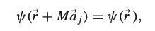
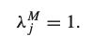
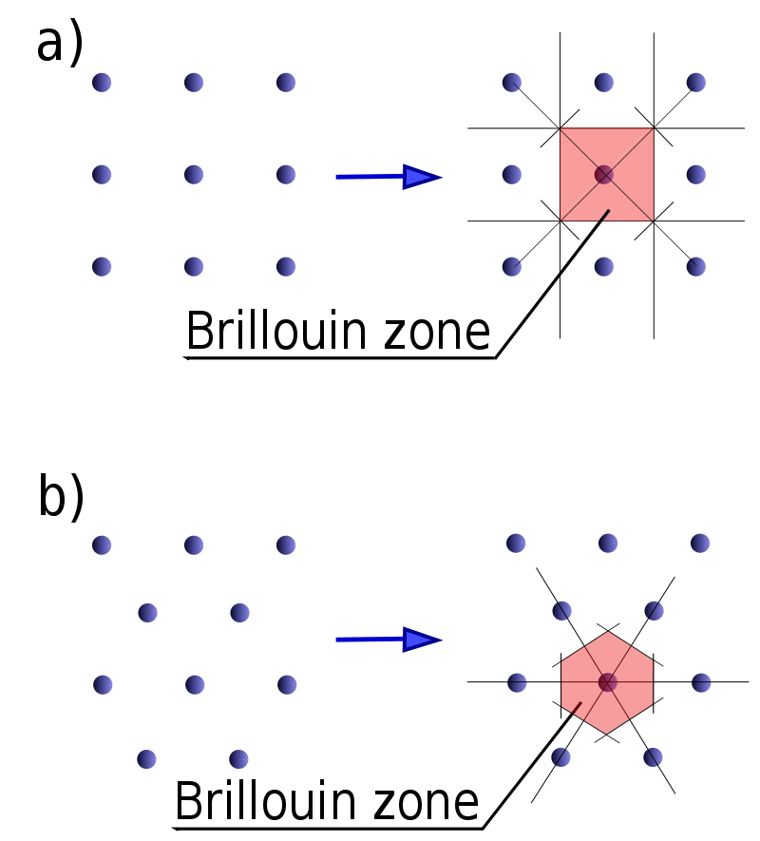
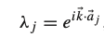
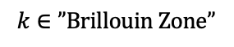
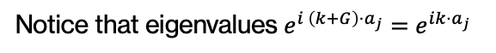
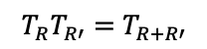


With periodic boundary conditions
Along with
$$T_{R}T_{R′}=T_{R+R′}$$
$$⇒$$
Notice that eigenvalues $e^{i \left(k+G\right)⋅a_{j}}=e^{ik⋅a_{j}}$
$$k∈”Brillouin Zone”$$
The most general form of an eigenfunction (that gives eigenvalue $λ_{j}$) is:
The Brillouin zone parameterizes the electron eigenstates in a crystal

Slide 11
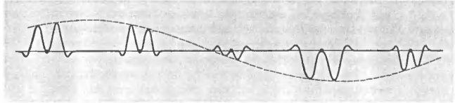
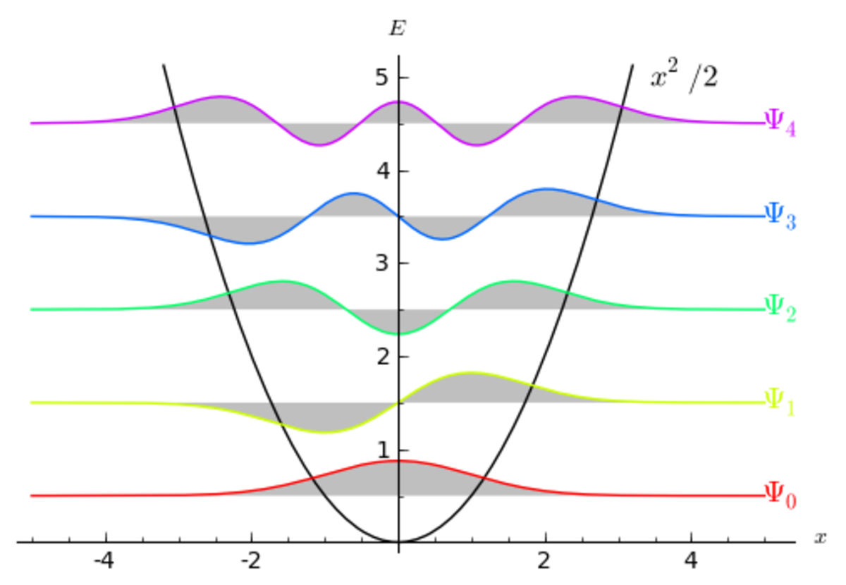
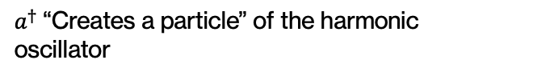

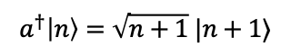
Planewave x cell periodic part
Heads up: Remember second quantization. Like that of the harmonic oscillator
$$a^{†}\left|n\right\rangle =\sqrt{n+1} |n+1⟩$$
$$a\left|n\right\rangle =\sqrt{n}|n−1⟩$$
$a^{†}$“Creates a particle” of the harmonic oscillator

Slide 12
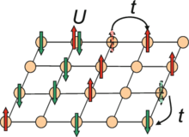

Hubbard Hamiltonian for square lattice
Toy model designed to capture essence of magnetic effects due to the coulomb interaction
Hopping term (kinetic energy decrease on delocalization).
Coulomb repulsion cost to sit on the same site
When we have N sites and N electrons in the system
Called ‘half filling’
(each site can support two particles)

Slide 13



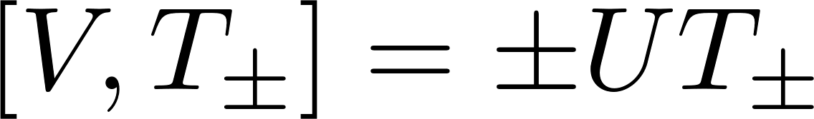
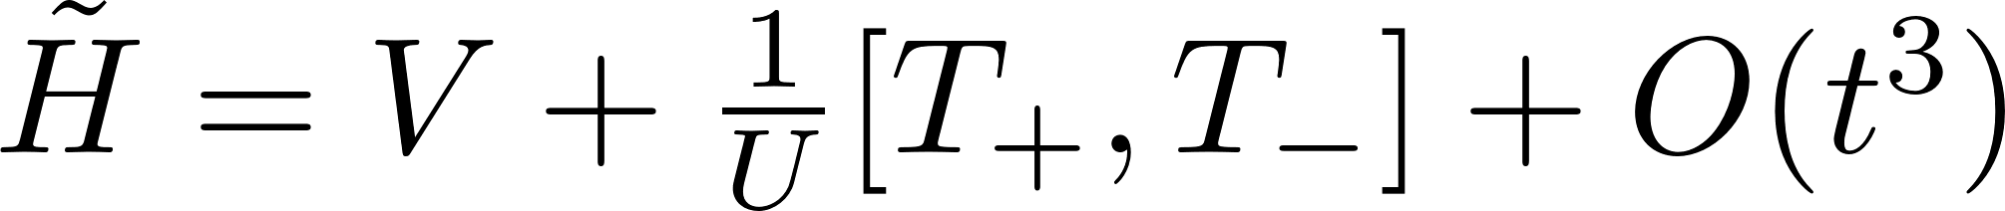

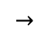
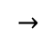
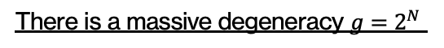
1. Let $t=0$. Ground state: electrons occupy one site (either spin). E = 0
There is a massive degeneracy $g=2^{N}$
No magnetic ordering preferred
2. Include hopping as a perturbation
(is any spin direction preferred?) (U>>t)
$$→$$
Hopping that decreases number of doubly occupied sites by 1
Hopping that increases number of doubly occupied sites by 1
$$→$$
Let
S is unitary!

Slide 14
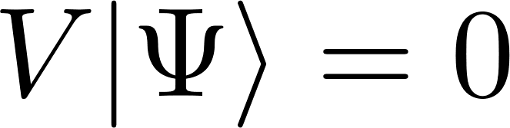
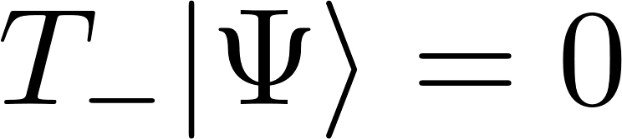
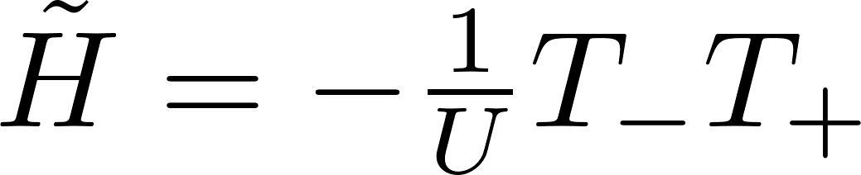





Ground state at half filling: no doubly occupied sites, so for all states
Effective Hamiltonian at half filling is
For pair of sites i and j
i
j
So,
$$J>0$$
: Spins alternating in direction (antiferromagnet)
Ground state =
(think classically)
$$J<0$$
: All spins pointing in one direction (ferromagnet)
What are the low lying excitations of the antiferromagnet?

Slide 15





Holstein-Primakoff approach (map to bosons)
Will do for ferromagnet and in analogy with Antiferromagnet
(for all down spins)
Philosophy: Large S expansion. Take spin to be large. Get exact solution. Hope if corrections are not big enough to not be observed in experiment
Let spin be S
At each site $s_{z}$ quantum # can be $m∈\{−S,−S+1,…,S−1,S\}$
Note:
Look very similar.
In fact we can have a mapping
With
Boson number operator

Slide 16








Similarly (suppress site index):
So,
Now writing Hamiltonian (Large S):

Slide 17





Fourier transform
Almost similar treatment for but with some subtleties for antiferromagnets. It Gives:
What is the rough image of this?

Slide 18

(Best animation I could find)
Ferromagnet
Collective motion- hence the title of the talk
*

Slide 19
That’s all folks!

Slide 20

Tight binding and the Hubbard model
More intuitive way to look at a crystal
Hydrogen atom chain
N hydrogen atoms with all electrons in the 1s orbital
Lattice constant
When the lattice constant ~ infinite, Eigenvalues of Hamiltonian = $E_{1s}$ (N degenerate) Eigenfunctions just one 1s orbital at each site (infinitely far away).
As we bring electrons closer.
Wavefunctions overlap slightly
Electrons at one site can “hop” from one site to the next.

